Slide 1


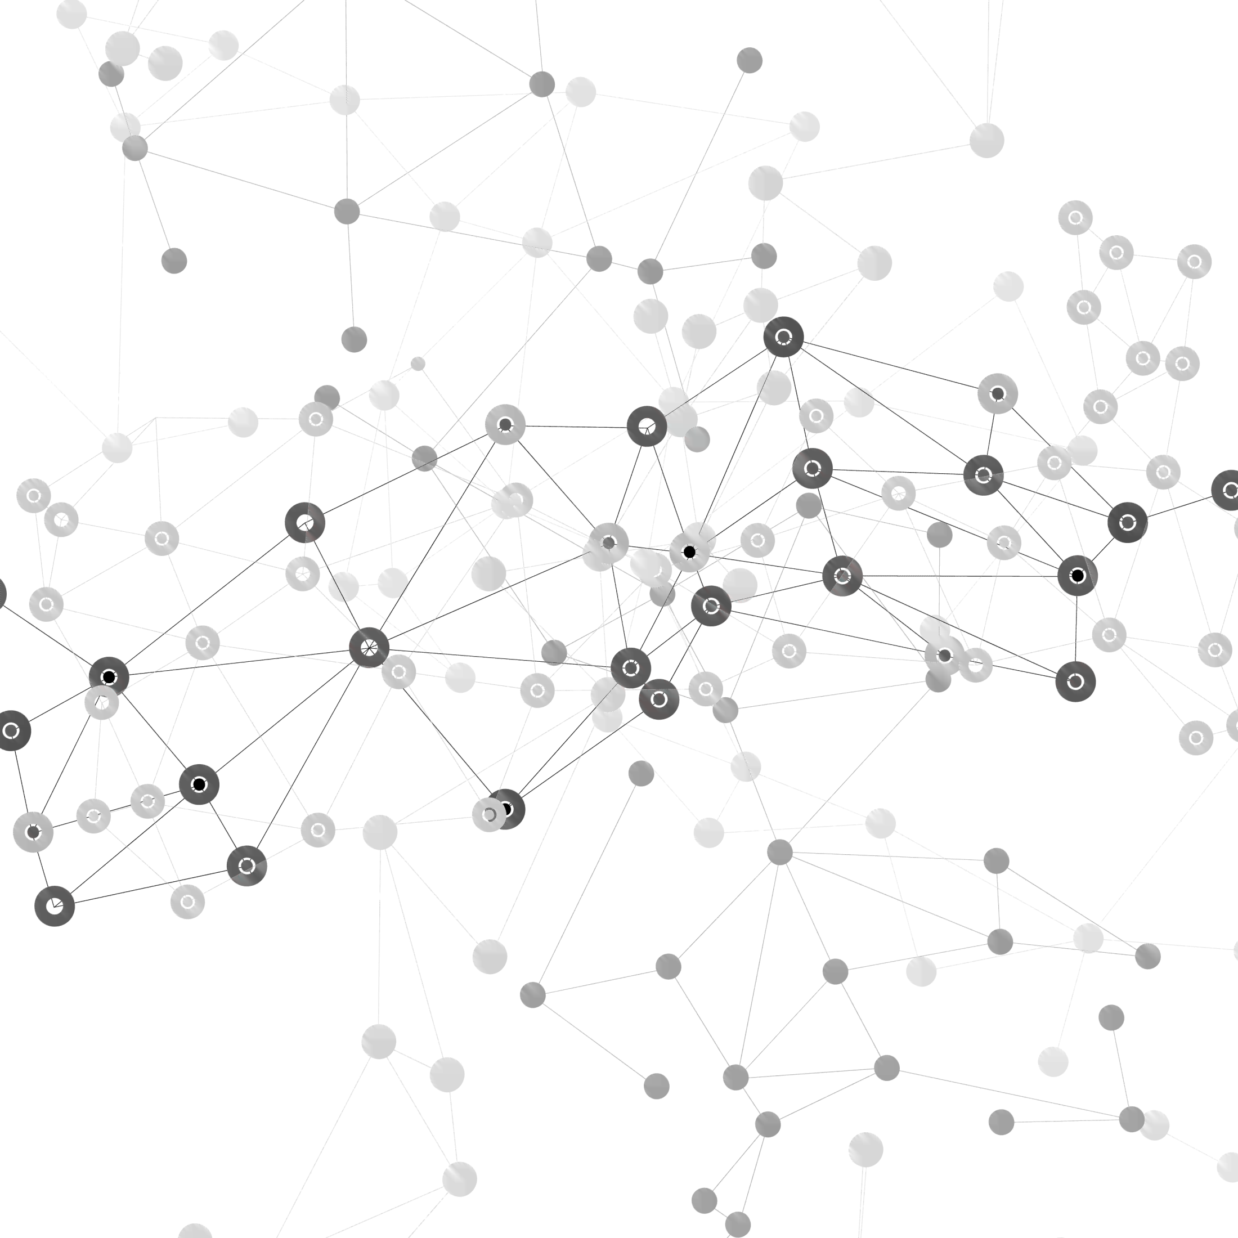
SHMU BLOG PROJECT REPORT
REPORTING TEAM: 1-th Team
TEAM MEMBERS:
刘哲峰
曾科特
李鹏飞
刘通

Slide 2
CONTENT
1.
2.
Project Demo
Project Executiion
3.
4.
Risk Plan
Test Plan
5.
6.
Lessons Learnt
Conclusion
7.
Future Plan

Slide 3
PART 01
Project Demo

Slide 4
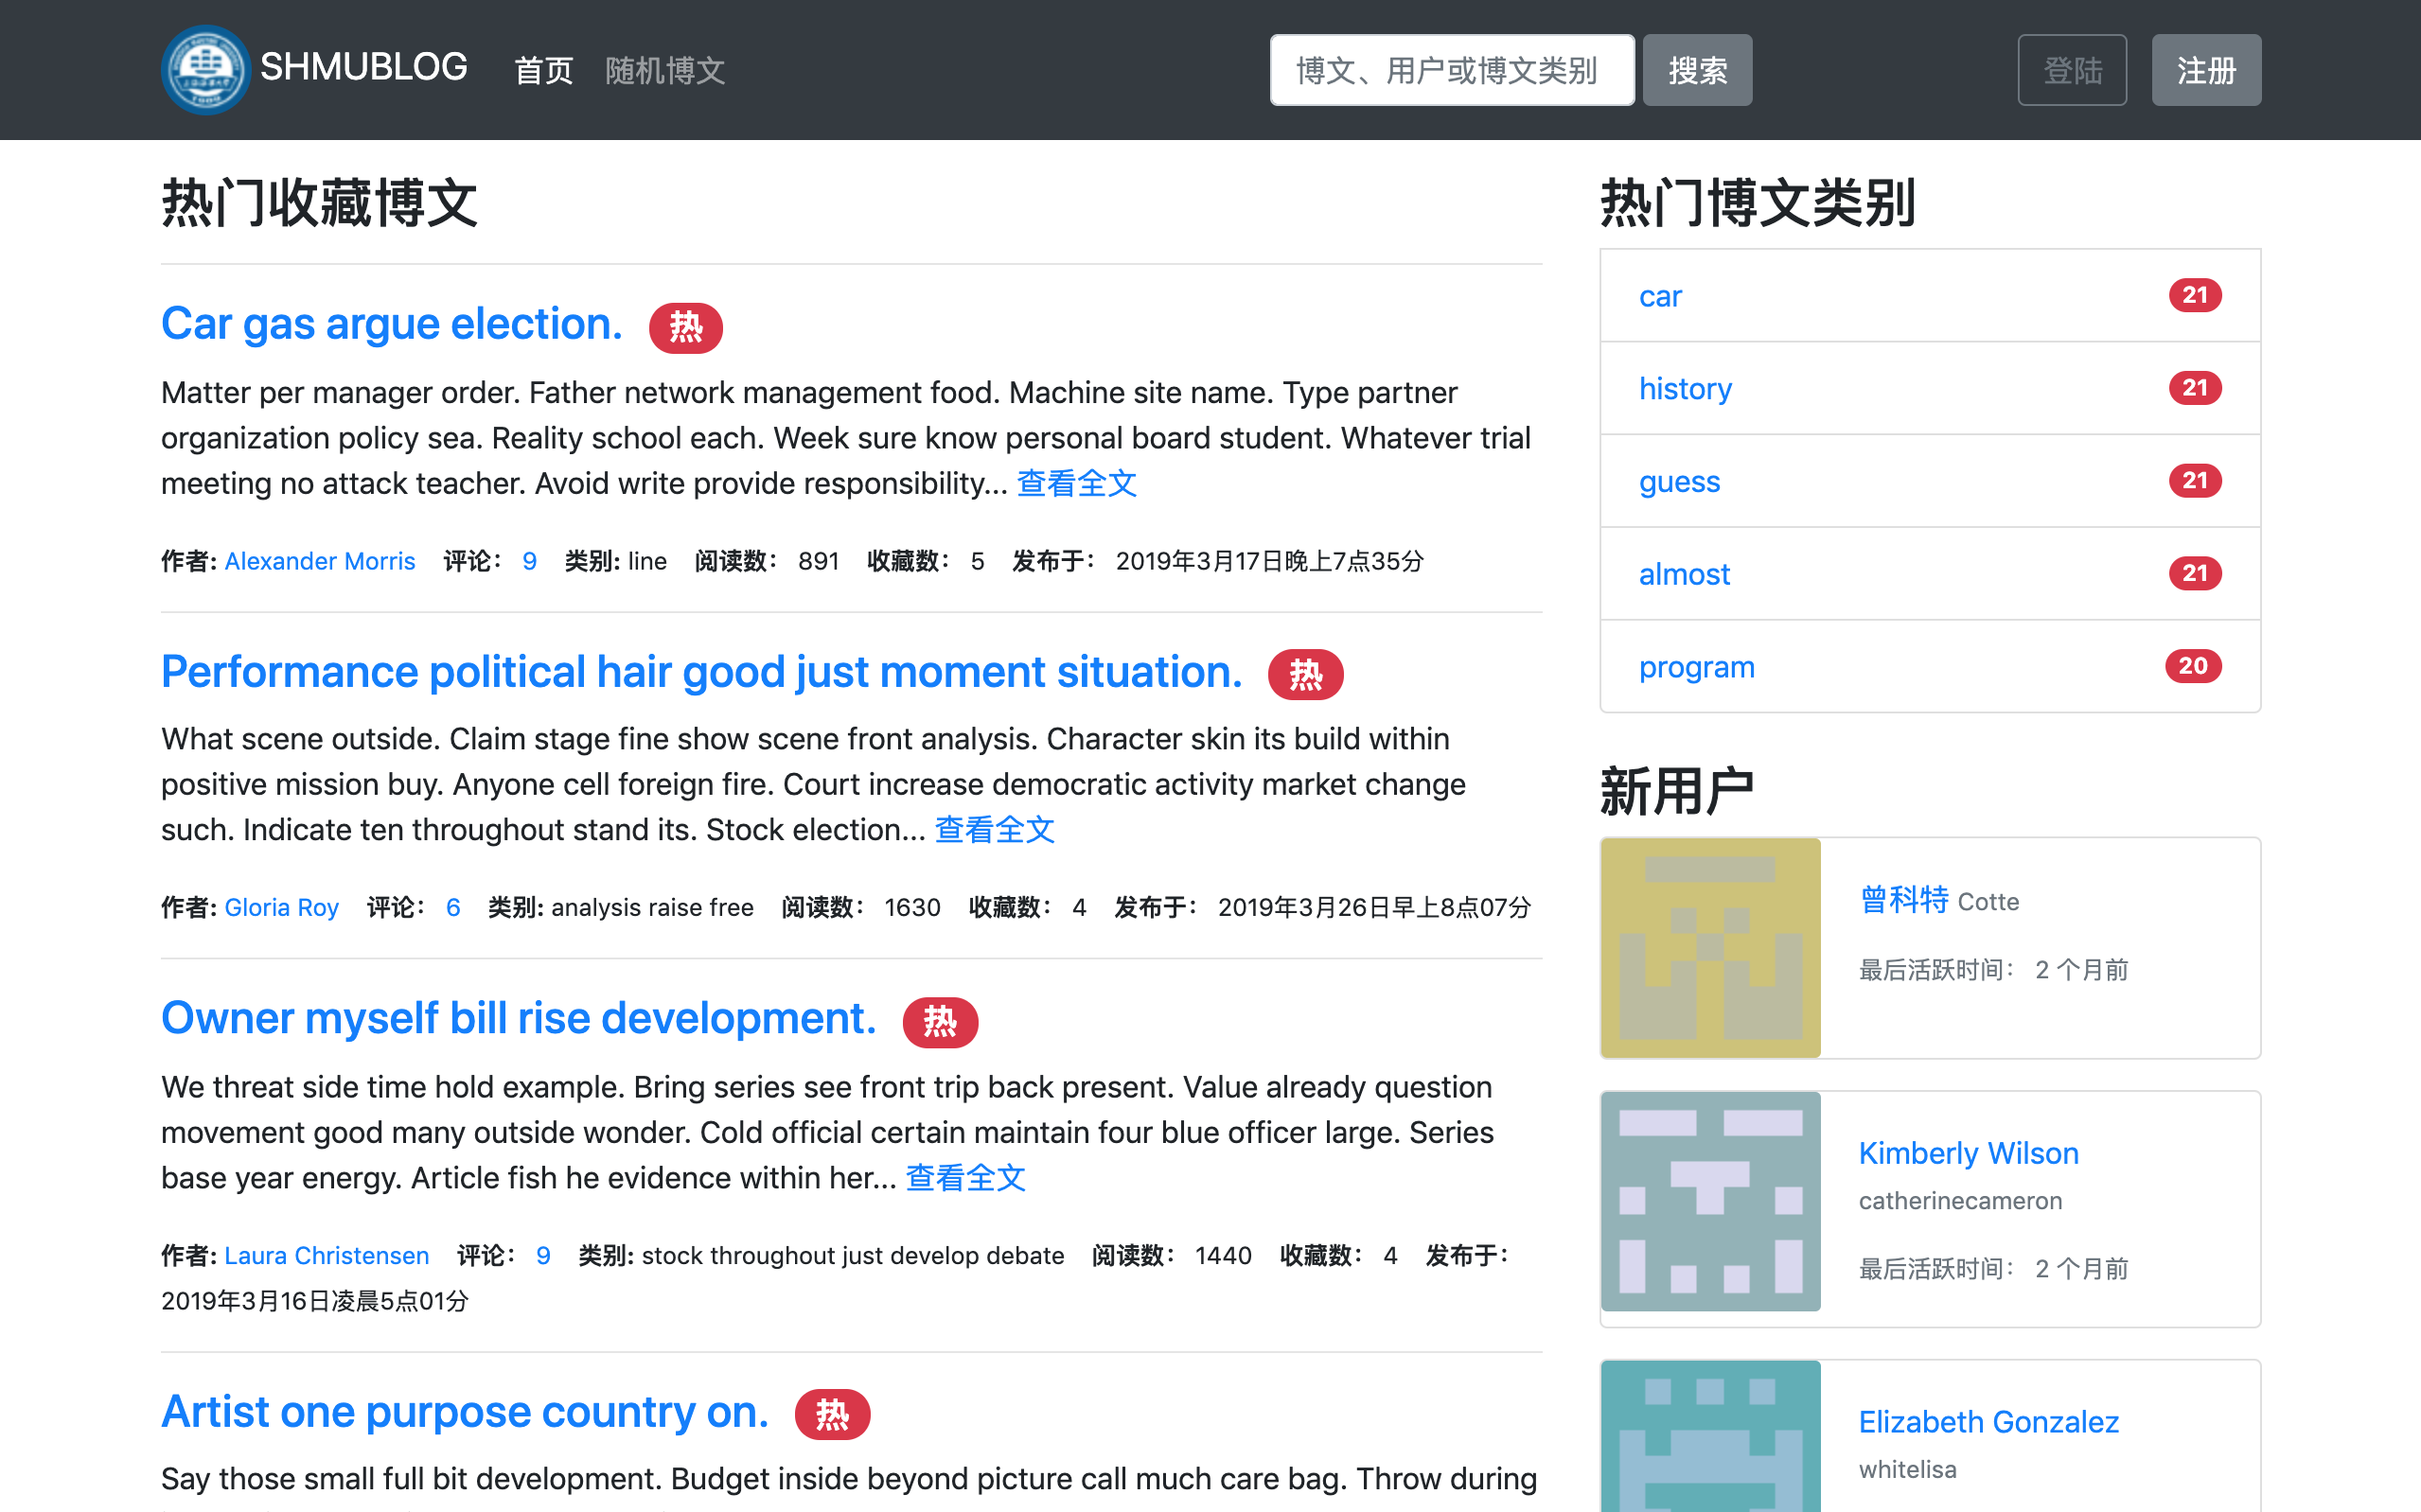
Project Demo
标题添加此处

Slide 5
PART 02
Project Execution

Slide 6
Project Execution
Milestone Name | Milestone Leader | Deliverables | Planed Completion Date | Actual Completion Date | Execution
Project Plan | 曾科特 | Project Plan Document | 2019.3.12 | 2019.3.12 | ✅
Detailed Design | 刘通 | Detailed Design Document | 2019.3.19 | 2019.3.19 | ✅
Complete the Project Infrastructure | 曾科特 | Project Infrastructure Code & Unit Test | 2019.3.26 | 2019.3.26 | ✅
Database Design | 刘哲峰 | Database Models Figure | 2019.4.9 | 2019.4.9 | ✅
Authorization Module | 曾科特 | Code & Unit Test | 2019.4.16 | 2019.4.16 | ✅

Slide 7
Project Execution
Milestone Name | Milestone Leader | Deliverables | Planed Completion Date | Actual Completion Date | Execution
User Module | 刘通 | Code & Unit Test | 2019.4.16 | 2019.4.16 | ✅
Article Module | 李鹏飞 | Code & Unit test | 2019.4.16 | 2019.4.16 | ✅
Administrator Module | 曾科特 | Code & Unit test | 2019.4.16 | 2019.4.16 | ✅
Home Page | 曾科特 | Code & Unit test | 2019.4.16 | 2019.4.16 | ✅
Test Plan | 刘哲峰 | Test Plan Document | 2019.4.16 | 2019.4.16 | ✅

Slide 8
Project Execution
Milestone Name | Milestone Leader | Deliverables | Planed Completion Date | Actual Completion Date | Execution
Executing Test Plan | 刘哲峰 | Document | 2019.4.30 | 2019.4.30 | ✅
Final Report | Whole Team | Final Report Document & PPT | 2019.5.19 | 2019.5.19 | ✅

Slide 9
PART 03
Risk Plan

Slide 10
Risk Plan
Failure to identify complex functionalities
and time required to develop those
functionalities
Wrong time estimation
Unexpected project scope expansions
Continuous changing requirements

Slide 11
PART 04
Test Plan

Slide 12
Unit Test
序列 | 被测函数 | 测试功能 | 测试状态
1 | test_bad_permission() | Permission to login | success
2 | test_login_blocked_user() | Verify blocked users | success
3 | test_fail_login() | fail login | success
4 | test_register_account() | register | success
5 | test_user_index_page() | write blog | success

Slide 13
Unit Test
序列 | 被测函数 | 测试功能 | 测试状态
1 | test_bad_permission() | Permission to login | success
2 | test_login_blocked_user() | Verify blocked users | success

Slide 14
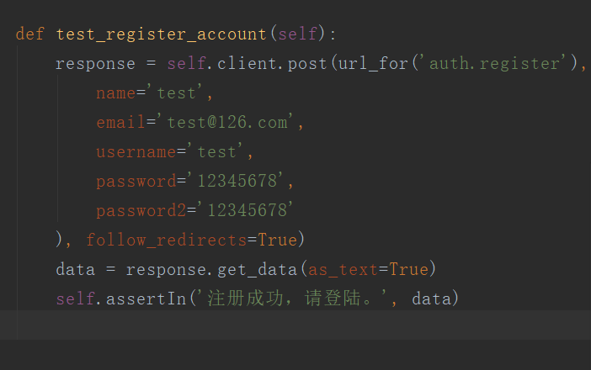
Test Case

Slide 15
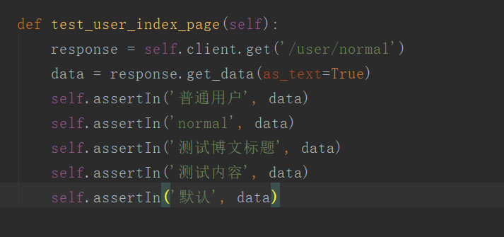
Test Case

Slide 16
PART 05
Lessons Learnt

Slide 17
Lessons Learnt
Mentality proplems
Team work and communication
technology

Slide 18
PART 06
Conclusion

Slide 19
Conclusion
Project Conclusion
Team Conclusion

Slide 20
PART 07
Future Plan

Slide 21
Future Plan
beautify the webpage
many functional modules that
need to be added or supplemented.
consider deploying the project on the server
Open to the public for use by teachers
and students on campus

Slide 22
2019
Thanks for your watching

